Slide 1
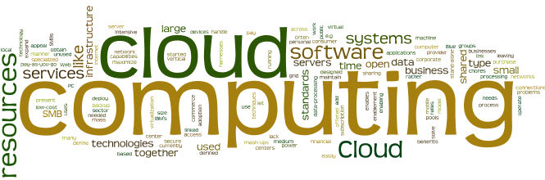
Cloud Computing Fundamentals

Slide 2
Module Objectives
You should able to answer below questions end of this module.
What are the virtualization components ?
What are the virtualization types
What are the virtualization layers ?

Slide 3

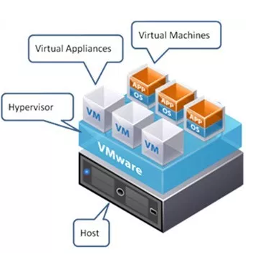
Virtualization Terminology
Host : A host is a computer offering information resources, services, and applications to users or other computers on the network. Hosts are assigned at least one network address.
Virtual Machines (VM) : A set of virtual hardware devices, including virtual CPU, virtual RAM, virtual I/O devices, and other virtual hardware devices. It resembles and behaves like a traditional, physical server and runs a traditional operating system (OS), such as Windows or Linux.
Many products and technologies today provide a platform on which VMs can be built and run. Although these technologies may have many fundamental differences, they tend to share these characteristics:
Many VMs can run on each physical host concurrently.
VMs running on the same host are isolated from one another.
The OS installed on the VM is unaware that it is running in a VM.
Administrators and users in one VM cannot access the underlying host OS or the guest OS of other VMs running on the same host.
Virtual Machine can be , Server (Virtual Server) , Desktop ( Virtual Desktop) , VM Guest OS or classic part of computer can be call Virtual CPU (vCPU) , Virtual Disk (vDisk) etc.

Slide 4
Virtualization Terminology (continued)
Hypervisor : A thin OS designed solely to provide virtualization. It drives physical hardware, executes VMs, and dynamically shares the underlying hardware with the associated virtual hardware. It is not intended to serve directly as a general-purpose OS, instead, it provides the platform on which VMs can run.
In other terms, we can say it will provide an illusion that each OS is running on their own physical hardware.

Slide 5
Virtualization Terminology (Cont.)
Virtual Appliance : A pre-built VM containing pre-installed software that can be easily implemented. Typically, the appliance is downloaded from a website as an OVF file, deployed into the virtual infrastructure, and easily configured using the console of the VM and a web browser. Most virtual appliances allow very simple implementation, relieving the customer of a complex installation and configuration.
Open VM Format (OVF) : A specification that can be used to export and import VMs from one virtual environment to another. Typically, virtual appliances are stored in the OVF format

Slide 6
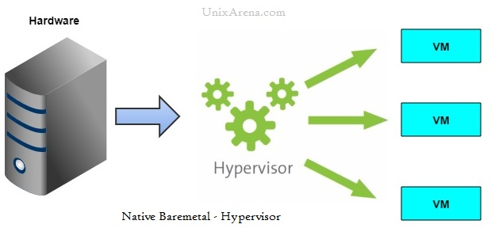
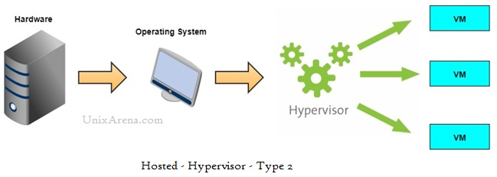
Virtualization Types
Hypervisor : There are two types of Hypervisors
Type-1 Hypervisor: These type of Hypervisors will load directly on physical hardware. It means there will be no OS hosted on physical layer as these Type-1 hypervisors will take care of everything to manage VM’s and its underlying physical hardware some of the Type-1 Hypervisors are Microsoft Hyper – V ,VMWare ESX/ESXi , Citrix XenServer
Type-2 Hypervisor: These type of Hypervisors will install as an application on the Operating System hosted on Physical Server. These type of Hypervisors can be used on our regular laptop’s or desktops where we can install and create a new Virtual Machine hosted with Linux or Mac. Some of the Type-2 Hypervisors are
VMWare Workstation , Microsoft Virtual Server ,VMWare Fusion supports only on Mac OS

Slide 7
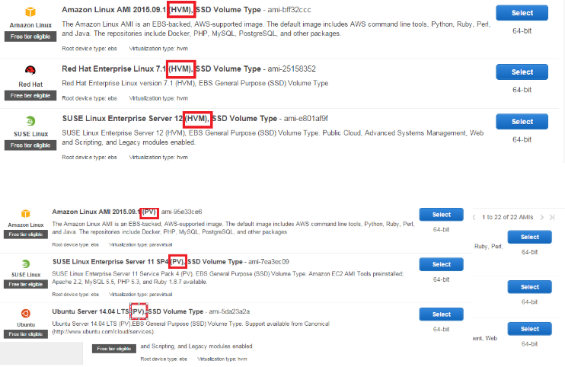
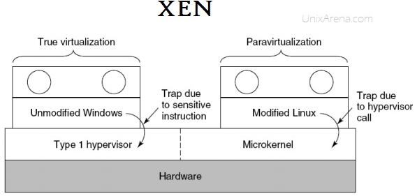
Full Virtualization vs Paravirtualization
A software component that is aware that it is running in a VM. For example, a paravirtualized virtual device driver runs in a VM that communicates with the underlying host OS. Typically, a paravirtualized driver is optimized to share queues, buffers, or other data items with the underlying host OS to improve throughput and reduce latency.

Slide 8
Layer of Virtualization

Slide 9
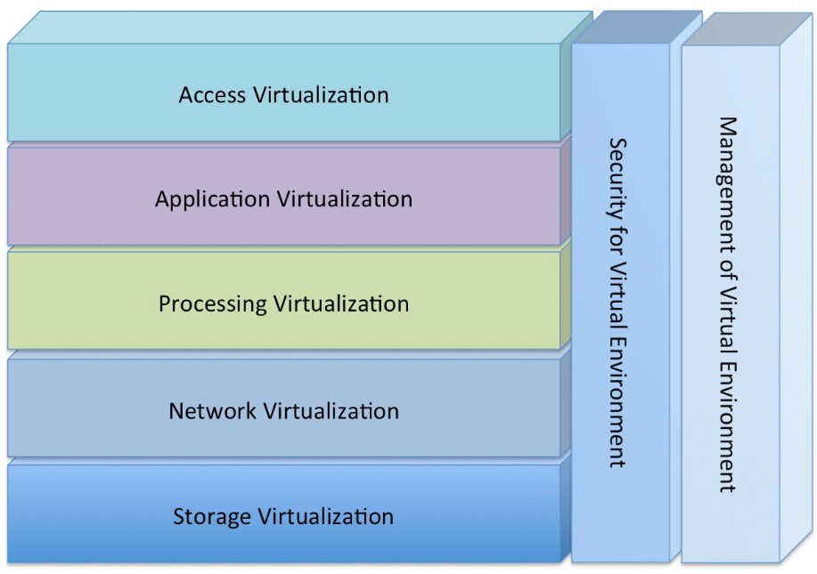
Layer of Virtualization Model
There are many layers of technology that virtualize some portion of a computing environment.
Layer of virtualization is a model that eliminates the dependency by creating an abstraction layer between the hardware and the software that runs on it.
The aim of this model is to centralize the information system for facilitating administrative task while improving scalability.
Source :Dan Kusnetzky

Slide 10

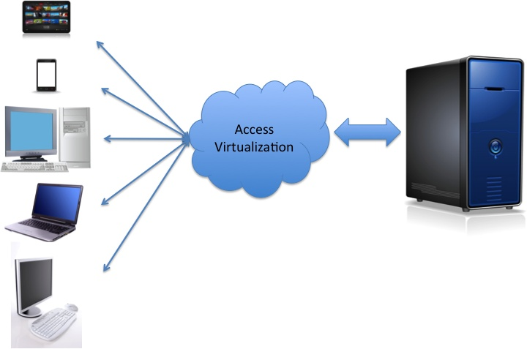
Layer of Virtualization : Access Virtualization
Hardware and software technology that allows nearly any device to access any application without either having to know too much about the other.
In some cases, special purpose hardware is used on each side of the network connection to increase performance, allow many users to share a single client system or allow a single individual to see multiple displays.
Access virtualization technology makes it possible for the remote device to display the user interface of a remote application and accept keyboard, mouse, and other input from the user.
The flow continues to applications or workloads running on the following types of devices:
• Physical systems
• Virtual systems (virtual desktop, virtual client, or virtual server)
Possible applications : Cost reduction , Agility ,Device independence , Better Security , Better availability
App-01
App-01
App-01
Apps

Slide 11
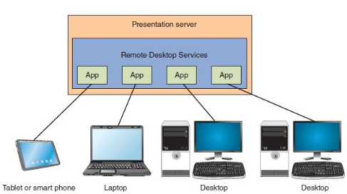
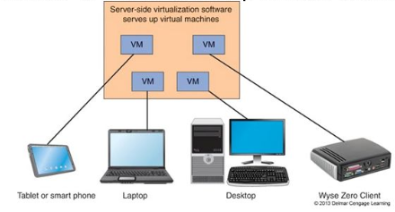
Layer of Virtualization : Application Virtualization
Software technology allowing applications to run on many different operating systems and hardware platforms.
This usually means that the application has been written to use an application framework. It also means that applications running on the same system that do not use this framework do not get the benefits of application virtualization.
There are two different forms of application virtualization, client-side and server-side. They make it possible for applications to run in a protected, isolated, or artificial environment.
Possible applications :Virtual Desktop Infrastructure (VDI ) , Application isolation ,O/S independency ,Scalability , Cost& Security
Client-Side Application Virtualization
Server-Side Application Virtualization

Slide 12
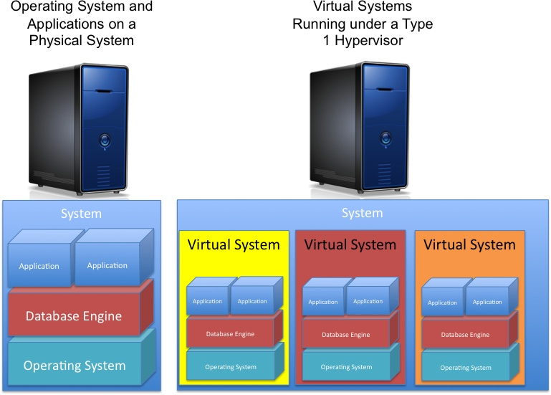
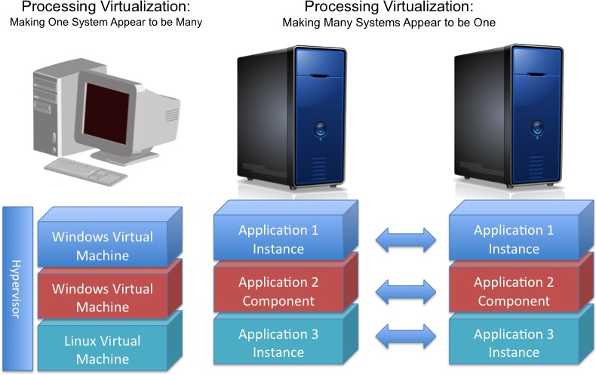
Layer of Virtualization : Processing Virtualization
This type of Virtualization technology can make one system appear to be many or many systems appear to be a single computing resource to achieve goals ranging from raw performance, high levels of scalability, reliability/availability, agility or consolidation of multiple environments onto a single system.
Making one system appear to be many Virtual machine software allows the entire stack of software that makes up a system to be encapsulated into a virtual machine file. Then a hypervisor can run one or more complete virtual systems on a physical machine. (Performance ,Cost etc.)
Making many systems appear to be one Parallel processing monitors make it possible for many machines to execute the
same applications or application components, with the goal of reducing the processing time of the application.( Load Balancing, HA etc.)

Slide 13
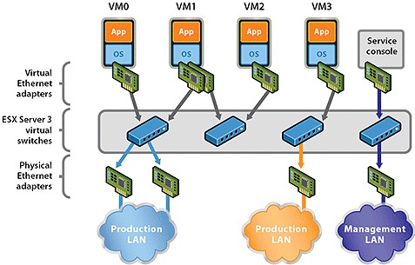
Layer of Virtualization : Network Virtualization
Network Virtualization provides network functionality purely based on software and it often is supported by network routers, network switches, network cards
Systems executing the organization’s applications and workloads may not know this is happening. Client systems and server systems just see the network as presented by those network resources.

Slide 14
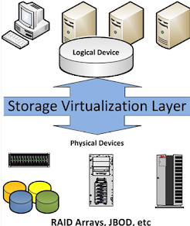
Layer of Virtualization : Storage Virtualization
This technology also makes it possible for many systems to share the same storage devices without knowing that others are also accessing them. This technology also makes it possible to take a snapshot of a live system so that it can be backed up without hindering online or transactional applications.
DAS :Direct-attached storage is a fairly basic, low-maintenance, low-cost solution where the storage system is a part of the actual host computer or connected directly to the host computer. This could be as simple as an external hard drive and it’s the opposite of network storage, where workstations and servers connect through a network
SAN :A storage area network is a dedicated, high-performance storage system that transfers block-level data between servers and storage devices. SAN is typically used in data centers, enterprises or virtual computing environments.
NAS :Network-attached storage offers dedicated file serving and sharing through a network
Storage Architecture : RAID,JBOD,
HDD interface : SCSI , SAS , ATA, SATA, Fibre Channel (FC)

Slide 15
Security for virtual environments refers to the tools necessary to control access to and use of all of the other layers of virtualization technology.
Security for Virtual Environments
Depending upon the approach
Security can require a small piece of software, often called an agent, to be added to each virtual resource or
Capture the stream of network communication going from server to server, from application to application, from storage device to server. This way, a great deal of processing can be done on each stream of communication to filter out worms, viruses, malware, and the like. This function is often combined with other management functions, such as configuration management, performance management, or automation of tasks. This approach does not require that agents be installed on each resource.

Slide 16
Management for Virtual Environments
Management for virtual environments refers to the tools necessary to install virtual environments and to watch, analyze, control, automate, and optimize what they are doing.
As virtual environments become more and more complex, this layer of virtualization technology becomes more and more important. We have already reached a point at which human operators cannot track what is happening in real time and respond before there is a slowdown or failure.
Technology used for management of virtual environments includes the following functions:
• Creating virtual environments or components of virtual environments
• Provisioning those environments or components
• Monitoring their execution
• Controlling execution of virtual environments or components
• Analyzing execution log data to find configuration, performance, or operational issues
• Optimizing use of virtual environments or components
• Automating use of virtual environments or components

Slide 17
Both virtualization and Could solutions can help maximize your current resources and technology dollars
Virtualization on a small scale : virtualization is a software which creates “separated” multiple images of the hardware and software on the same machine. This makes possible to install multiple OS, multiple software and multiple applications on the same physical machine.
Cloud computing for big applications :Cloud computing is a model for enabling convenient, on-demand network access to a shared pool of configurable computing resources
Virtualization doesn't depend upon cloud computing environment while without virtualization cloud computing can't exist.
Module Summary

